Slide 1
VASCULITIS
Dr.Nisha
Assistant professor
Dept:of practice of medicine

Slide 2
VASCULITIS
The vasculitides are a heterogeneous group of disease characterised by inflammation and necrosis of blood vessel walls, often with associated organ involvement.

Slide 3
The clinical features of vaculities are due to local tissue ischaemia and the systemic effects of widespread inflammation.
Primary systemic vasculitis is less common.secondary vasculitis can occur in SLE,RA,endocarditis and hepatitis B and C.

Slide 4
CLASSIFICATION OF VASCULITIS
LARGE VESSEL ARTERITIS
- Giant cell arteritis
- Takayasu’s arteritis
MEDIUM VESSEL ARTERITIS
- Classical polyarteritis nodosa
- Kawasaki disease
SMALL VESSEL ARTERITIS
- Microscopic polyangitis
- Wegener’s granulomatosis
- Churg- strauss syndrome
- Henoch-Schonlein purpura
- Mixed essential cryoglobulinaemia

Slide 5
LARGE VESSEL ARTERITIS

Slide 6
GIANT CELL ARTERITIS
TAKAYASU’S ARTERITIS

Slide 7
GIANT CELL ARTERITIS(GCA)
It is a large vessel vasculitis predominantly affecting branches of the temporal and
ophthalmic arteries.
Mean age of onset is 70yrs.
female:male ratio is 4:1

Slide 8
CLINICAL FEATURES
Always insidious in onset takes several weeks or months.
Headache - often localised to the temporal or occipital region with scalp tenderness.
Jaw pain – occurs while chewing or talking,its due to ischaemia of the masseters.
Visual disturbance – occlusion and acute anterior ischaemic optic neuropathy(vasculitis of posterior ciliary artery.)
Damage to optic nerve-loss of visual acuity and field,reduced colour perception

Slide 9
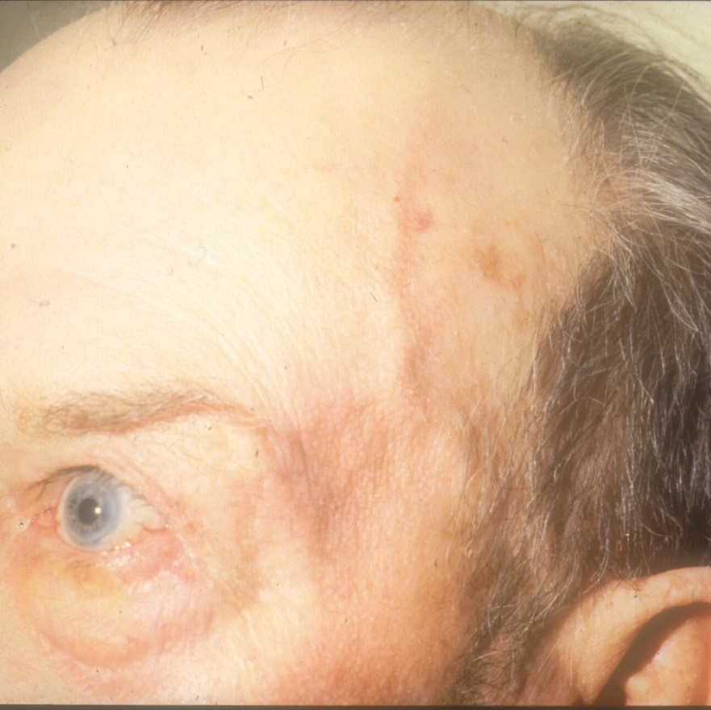
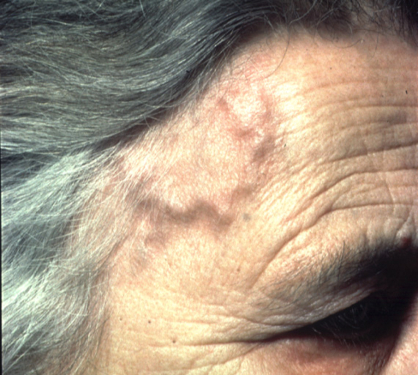
GIANT CELL ARTERITIS

Slide 10
INVESTIGATIONS
ESR may be elevated above 50mm/hr
CRP will be elevated.
Temporal artery biopsy-characteristic findings are fragmentation of the internal elastic lamina with necrosis of the media in combination with a mixed inflammatory cell infiltrate.(skip lesions are common so negative biopsy does not exclude the diagnosis)

Slide 11
POLYMYALGIA RHEUMATICA
It is a clinical syndrome of muscle pain and stiffness.it is not a true vasculitis but there is a close association with giant cell arteritis.
It is predominately a disease of elderly.
The mean age of onset is 70yrs.
Women are affected more often,3:1 is the ratio.

Slide 12
CLINICAL FEATURES
The cardinal features are
Muscle stiffness and pain
Symmetrically affecting the proximal muscles of the neck,upper arms,less commonly the buttocks and thighs.
Marked early morning stiffness,often with night pain.
Constitutional features of weight loss,fatigue,depression,and night sweats
On examination-stiffness and painful restriction of active shoulder movement but passive movements are preserved.

Slide 13
INVESTIGATIONS
Elevated ESR above 40mm/hr
Elivated CRP.
Normochromic,normocytic anaemia.
MRI

Slide 14
2. TAKAYASU’S ARTERITIS
Its is a chronic inflammatory granulomatous panarteritis of elastic arteries-
the Aorta and its major branches and
occasionally pulmonary arteries.
female : male ratio is 8:1
Age of onset at 25 to 30 yrs,most common in Asia.
It is characterised by thickened and inflammed intima with out fibrinoid degeneration.

Slide 15
CLINICAL FEATURES
Most commonly involved vessels are –carotid,ulnar,brachial,radial and axillary arteries.
Claudication
Systemic symptoms like fever,arthralgia and weight loss.
On examination-loss of pulses,bruits,hypertension and aortic incompetence.

Slide 16
INVESTIGATIONS
Elevated ESR
Normocytic normochromic anaemia
Angiographic findings of coarctation,occlusion and aneurysmal dilatation.

Slide 17
MEDIUM VESSEL ARTERITIS

Slide 18
POLYARTERITIS NODOSA(PAN)
KAWASAKI DISEASE

Slide 28
2.KAWASAKI DISEASE
Acute systemic disorder of childhood.
Clinical features are:
- fever persisting more than 5 days
- bilateral conjunctival congestion
- erythema of lips,buccal mucosa
- acute cervical lymphadinopathy
- erythema of palms and soles
Investigations: polymorphonuclear leucocytosis
Thrombocytosis,elivated ESR and CRP.

Slide 29
SMALL VESSEL VASCULITIS

Slide 30
wegener’s granulomatosis
churg-strauss syndrome
henoch-schonlein syndrom
microscopic polyangitis
Cryoglobulinemic vasculitis

Slide 31
WEGENER’S GRANULOMATOSIS
It is a rare vasculitis,characterized by granulomatous infiltration or necrotizing vasculitis of upper or lower respiratory tract,eyes,kidneys or peripheral nerves.
Clinical features: -recurrent sinusitis,
-nasal obstruction
- nasal septal perforation
- cough and hemoptysis
- vasculitic skin rashes
- uveitis,keratitis can occur in eye
Investigations: - high ESR and CRP.
- Cytoplasmic anti neutrophilic antibodY
(c-ANCA)

Slide 32
CHURG-STRAUSS SYNDROME
EOSINOPHILIC GRANULOMATOSIS WITH POLYANGITIS:-
It is a small vessel vasculitis characterized by infiltration of the vessels with eosinophilic granulomas.
Necrotizing vasculitis occurs in several organs leads to skin nodules or rashes,myocarditis,pericarditis,renal involvement.
investigations: -peripheral blood eosinophilia,
- Presence of (p-ANCA)
- biopsy of affected tissue shows-infiltration with eosinophil rich granulomas.

Slide 33
HENOCH-SCHONLEIN SYNDROME
IMMUNOGLOBULIN A VASCULITIS-
It is the most common childhood vasculitis
It is a multisystem ,small vessel,IgA immunecomplex mediated disease.
Peak incidence is between the ages of 4 to 8 yrs with a male prepondrance.
Clinical features- nonthrombocytopenic purpura
- arthritis,arthralgia,
-GI and renal involvement
Investigation – immunofluorescence test-demontrates IgA deposits in the skin or kidney

Slide 34
THANK YOU…

